Slide 1


New insights on the correspondence between subjective affective experience and physiological responses from representational similarity analyses
Carlos Ventura-bort, Julia Wendt, & mathias weymar
Department of Biological Psychology and Affective Science, University of Potsdam, Germany

Slide 2
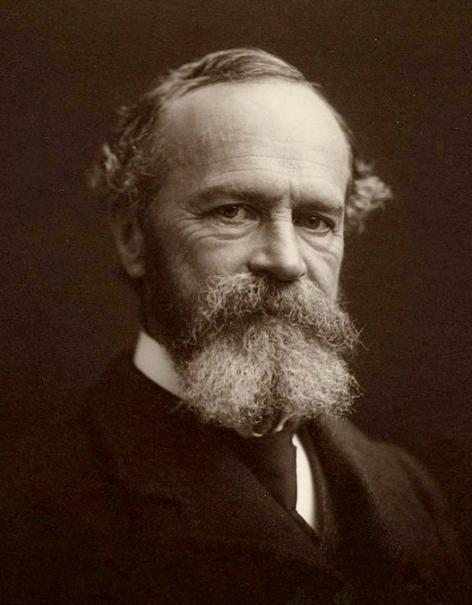
INTRODUCTION
Abstract the bodily symptoms from any strong emotion and it goes with them (James, 1890).
Bodily changes during ongoing experiences are an important aspect when determining that an event is pleasant, a sound feels activating, or a memory is terrifying
The extent of correspondence between physiological reactivity and the experienced subjective affect is still unclear.

Slide 3
INTRODUCTION
Classical views (Fingerprint hypothesis):
Strong correspondence between the experienced affect and the evoked physiological response.
Situations in which a similar affect is experienced, the same brain circuitry is activated, producing similar physiological responses within and across individuals (Hoemann et al., 2020; Siegel et al., 2018).
More recent views (Populations hypothesis):
There is no correspondence between the experienced affect and the evoked physiological response.
Similar affective experiences may produce different physiological responses and different affective experiences may evoke similar physiological responses (Hoemann et al., 2020; Siegel et al., 2018).

Slide 4
Goal of the study
To examine the correspondence between multiple physiological responses and subjective affective experiences, using representational similarity analysis (RSA), in different affect-inducing contexts.
Passive Picture Viewing (PPV)
Passive Sound Listening (PSL)
Mental Imagery
Using physiological indexes previously related to valence and arousal.
Skin conductance response (SCR)
Heart rate
Startle Blink Response
Corrugator activity

Slide 5
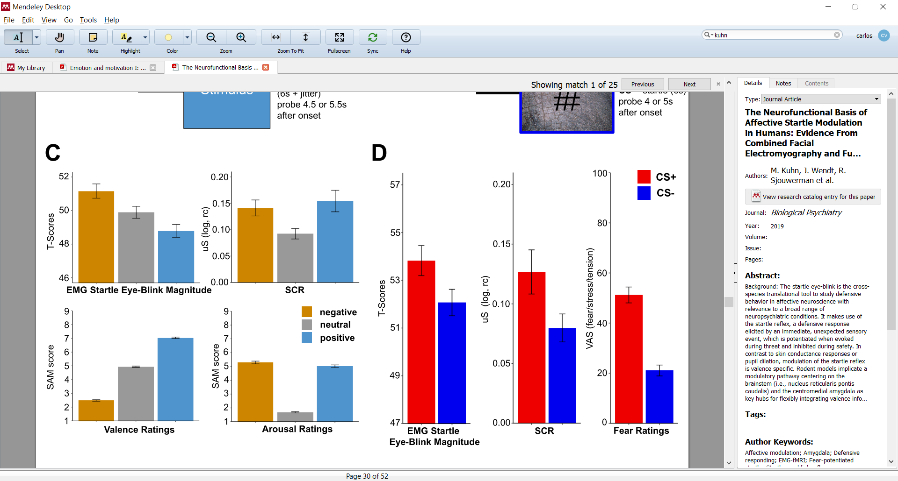
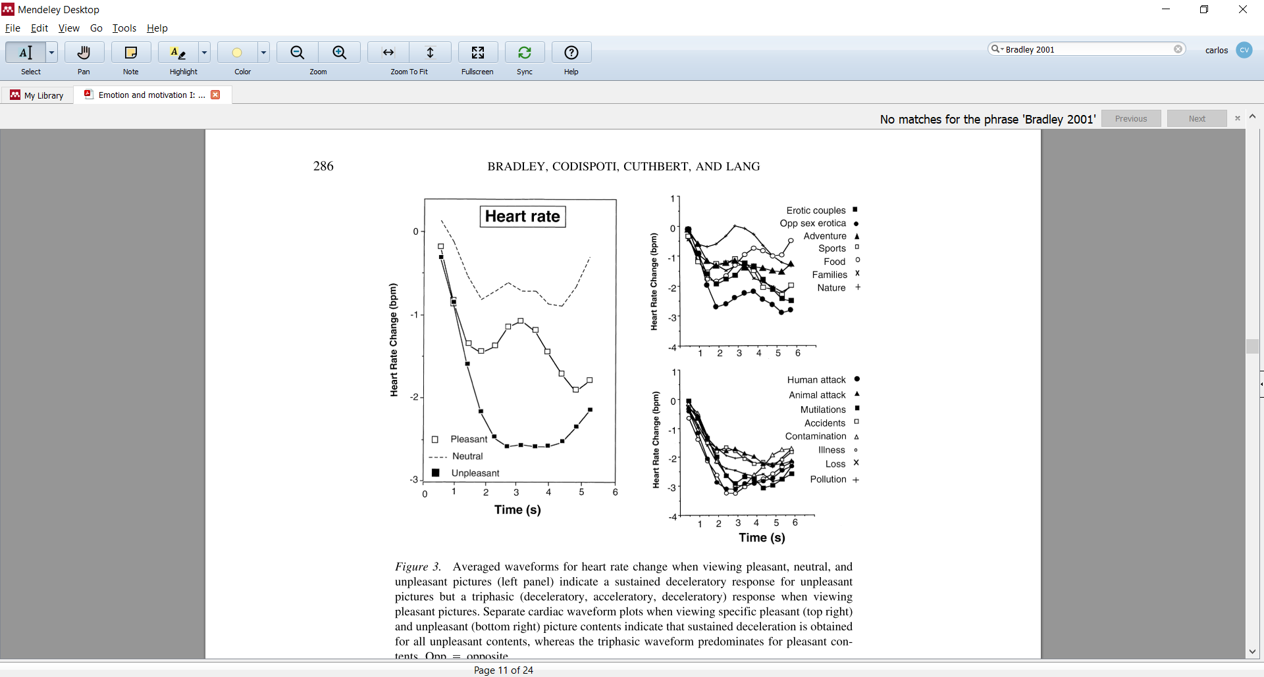
Physiological Indexes
Skin conductance response
Heart rate response
Kuhn et al., 2019
Bradley et al., 2001
Pictures, Sounds, and Imagery: ↑Arousal ↑ SCR
Pictures, Sounds: ↑Arousal ↓ HR
Imagery: ↑Arousal ↑ HR

Slide 6
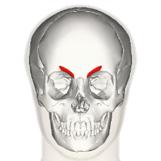
Physiological Indexes
Startle blink response
Corrugator activity
Kuhn et al., 2019
Bradley et al., 2001
Pictures Sounds: ↓ Valence ↑ STR
Imagery: ↑Arousal ↑ STR
Pictures Sounds and Imagery:
↓Valence ↑ Corr

Slide 7
Why RSA?
Allows comparing the correspondence of two different modalities
Evaluate the trial-by-trial similarities (representational dis/similarity matrices, RSMs)
Allowing to determine whether the output of these two different modalities is influenced by the same process.

Slide 8
Hypothesis
If a link between subjective affect and physiological reactivity exists, as proposed by the fingerprint hypothesis, the subjective and physiological RSMs should be similar to each other.
However, if the physiological responses are independent of the experienced affect, as stated by the populations hypothesis, no similarities should emerge between the subjective and physiological RSMs.

Slide 9
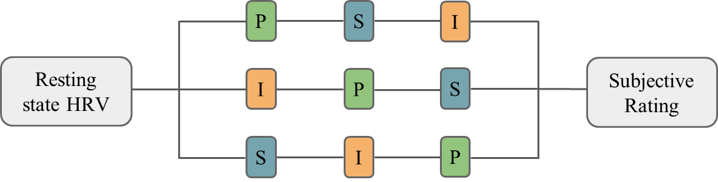
MATERIAL AND METHOD
Participants
64 students from University of Potsdam (51 women, mean age= 23.4).
Design
Pleasant, unpleasant, and neutral material.
Analysis
Representational Similarity Analysis (RSA)
P = Picture
S = sounds
I = Imagery

Slide 10
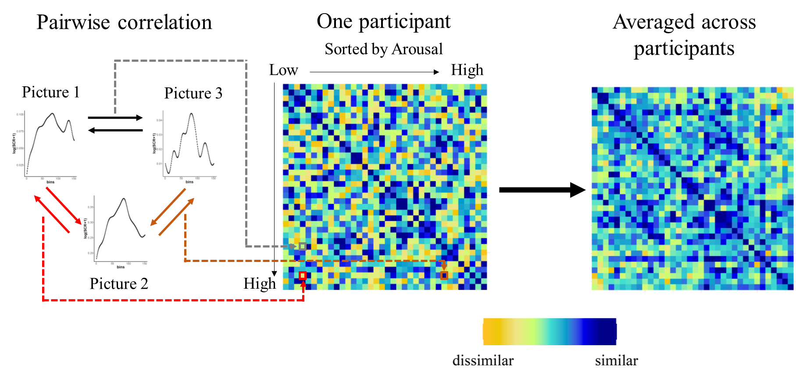
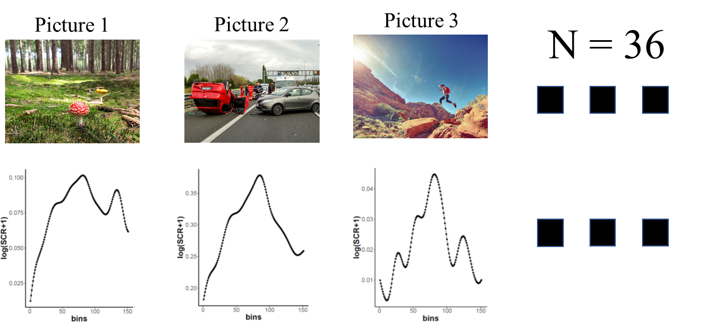
MATERIAL AND METHOD

Slide 11
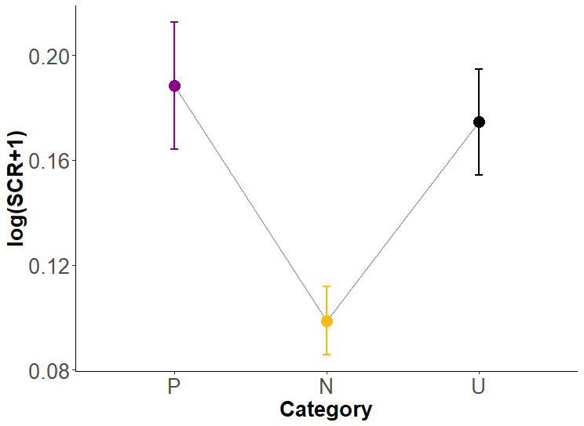
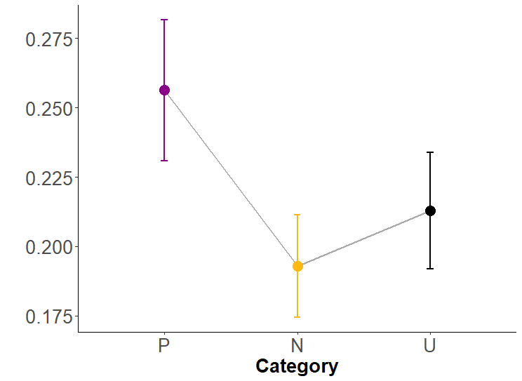
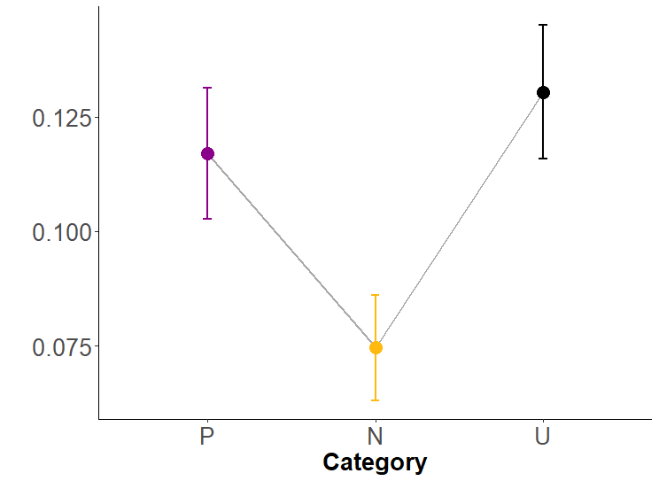
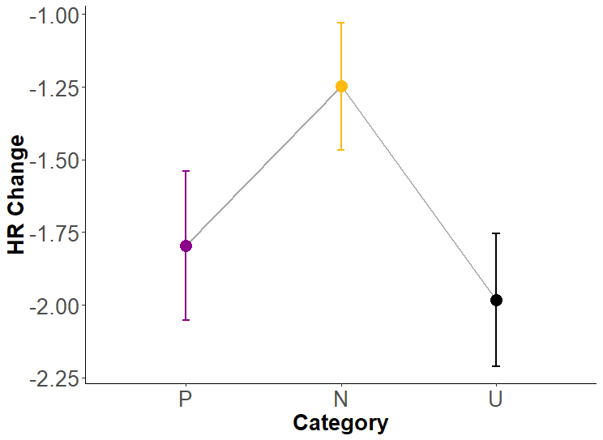
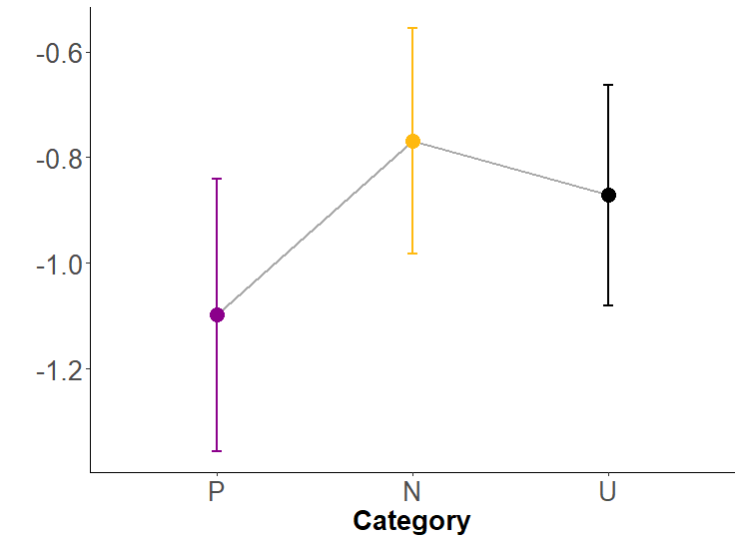
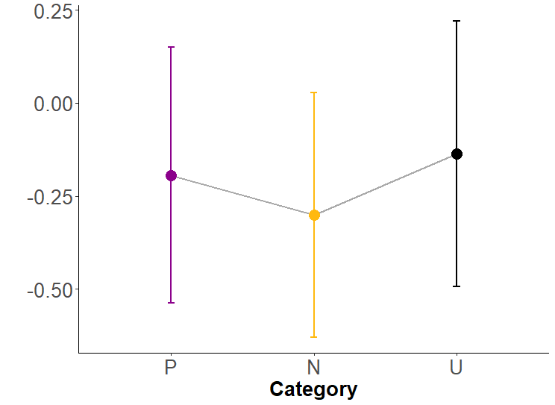
RESULTS
PPV Task
PSL Task
Imagery Task
*
*
*
*
*
SCR
*
*
Heart rate

Slide 12
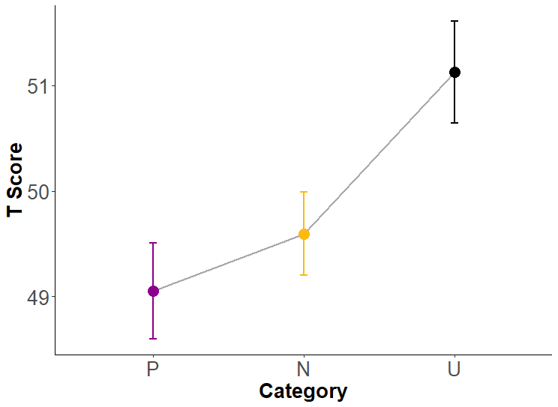
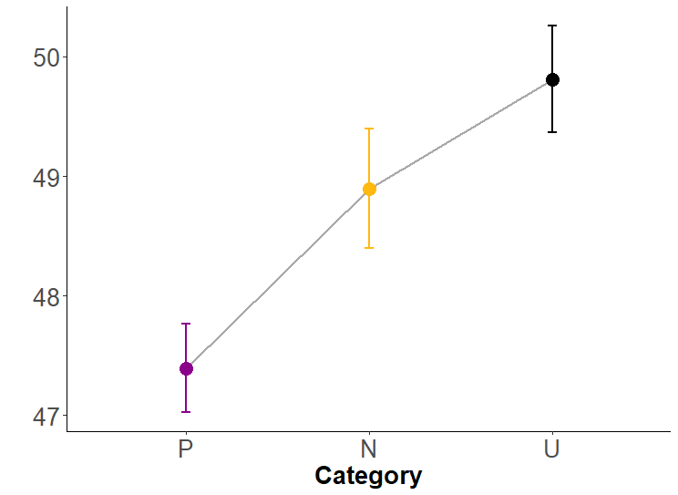
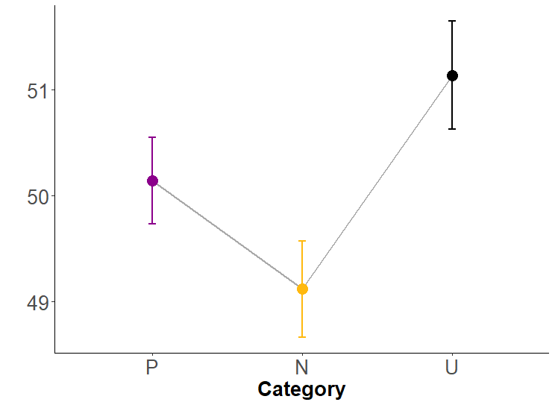
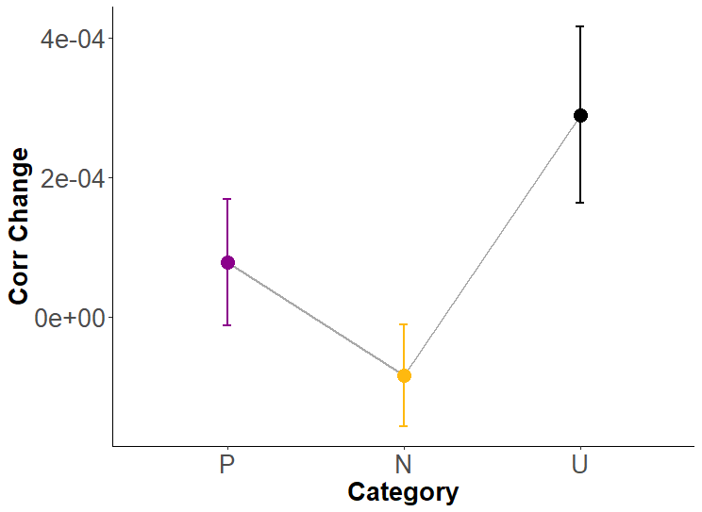
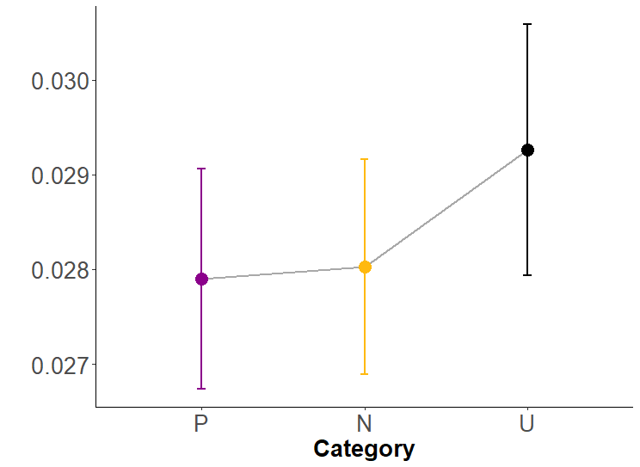
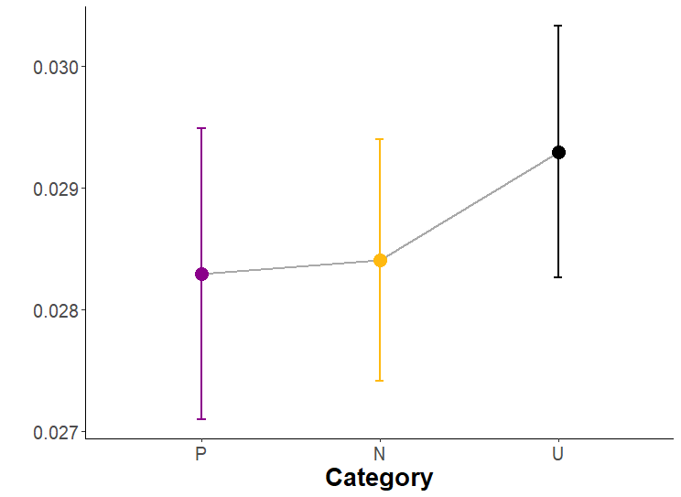
RESULTS
PPV Task
PSL Task
Imagery Task
*
*
*
*
*
Startle blink response
*
*
Corrugator activity

Slide 13
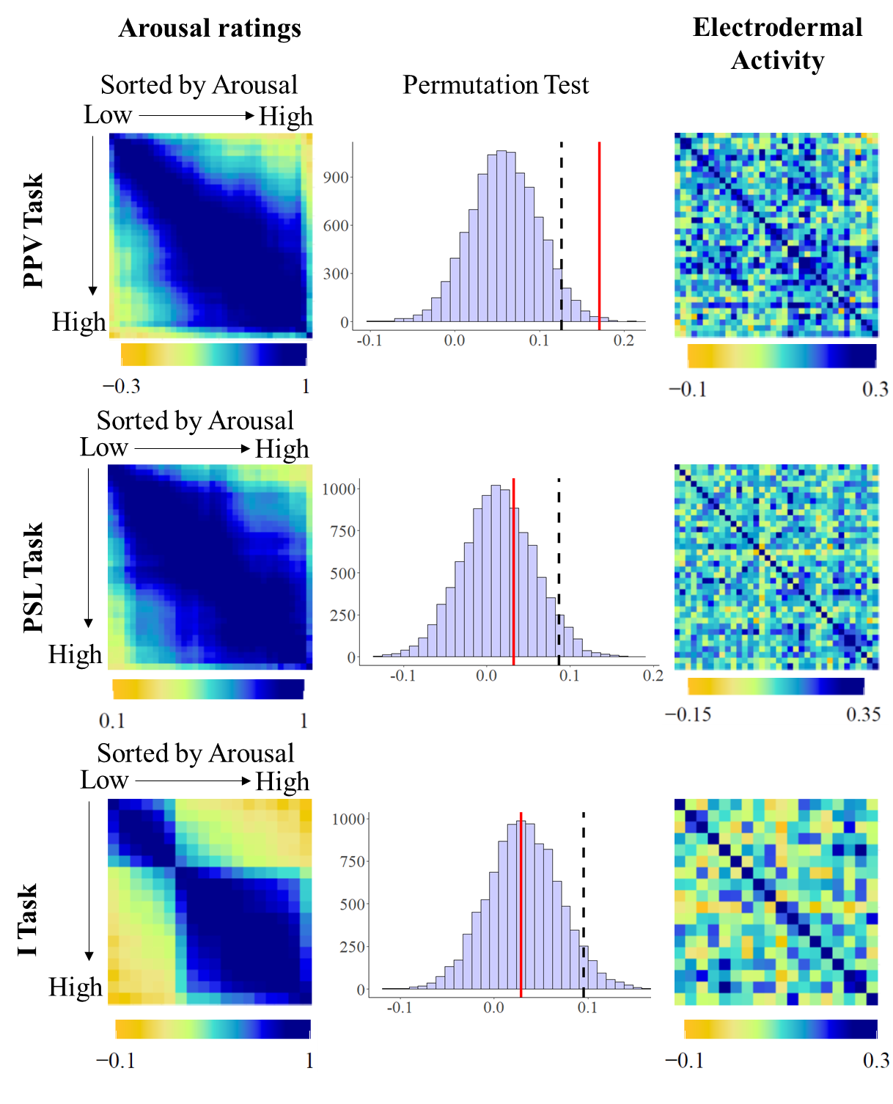
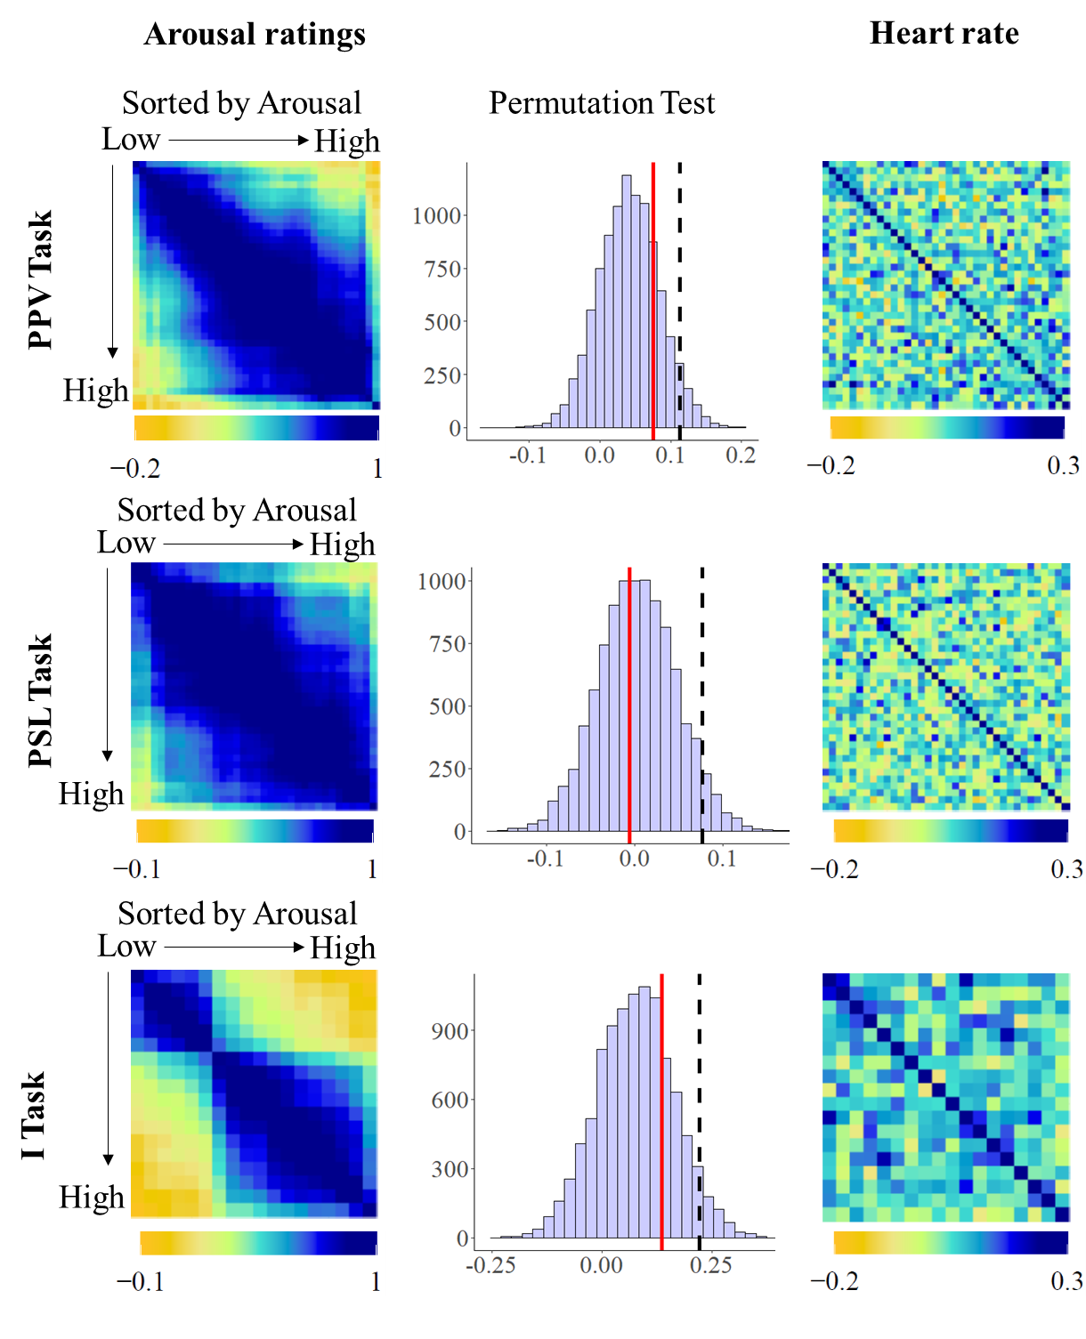
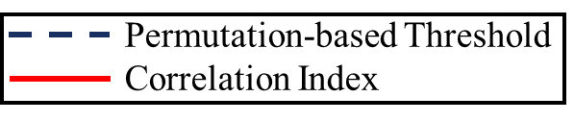
Results
AROUSAL AND SCR
AROUSAL AND HEART RATE

Slide 14
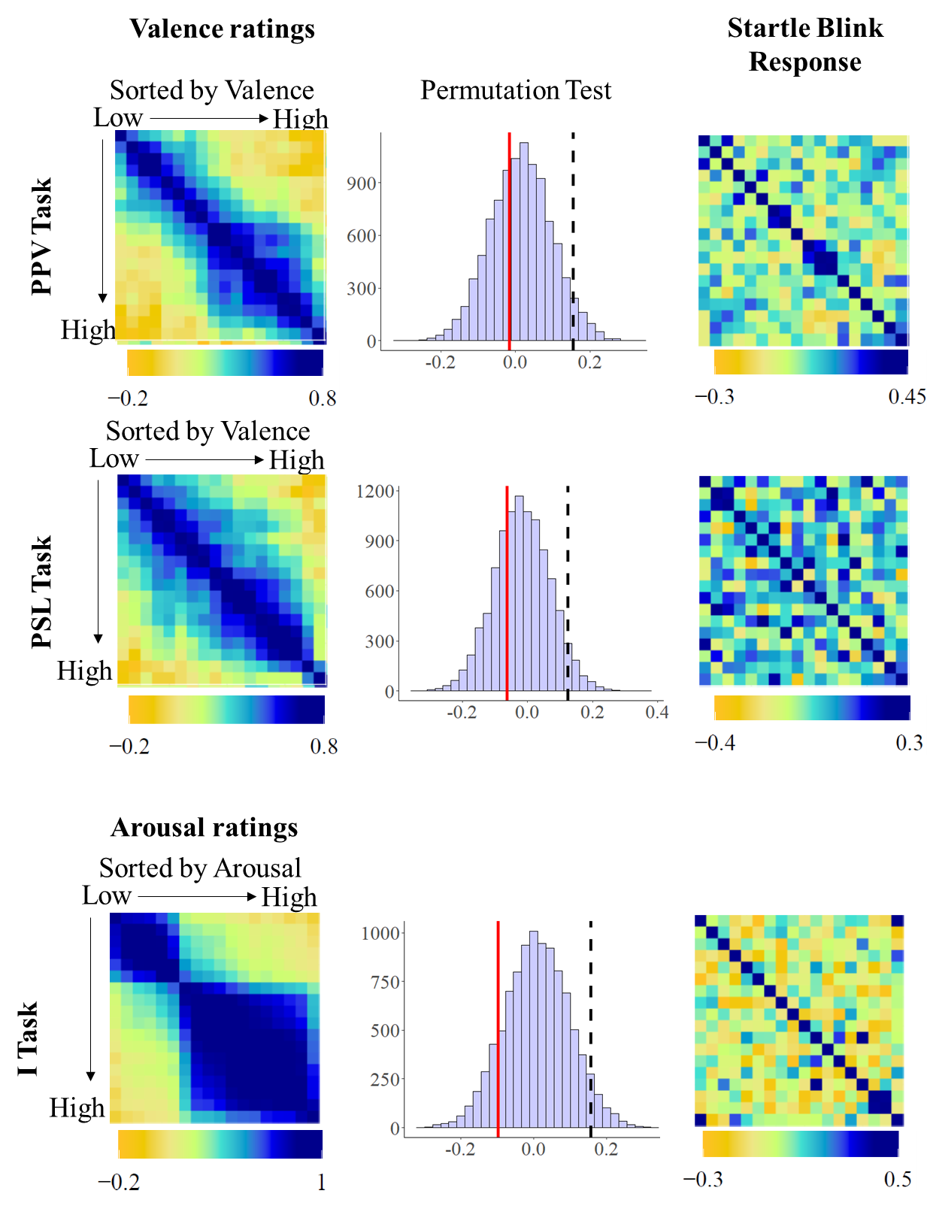
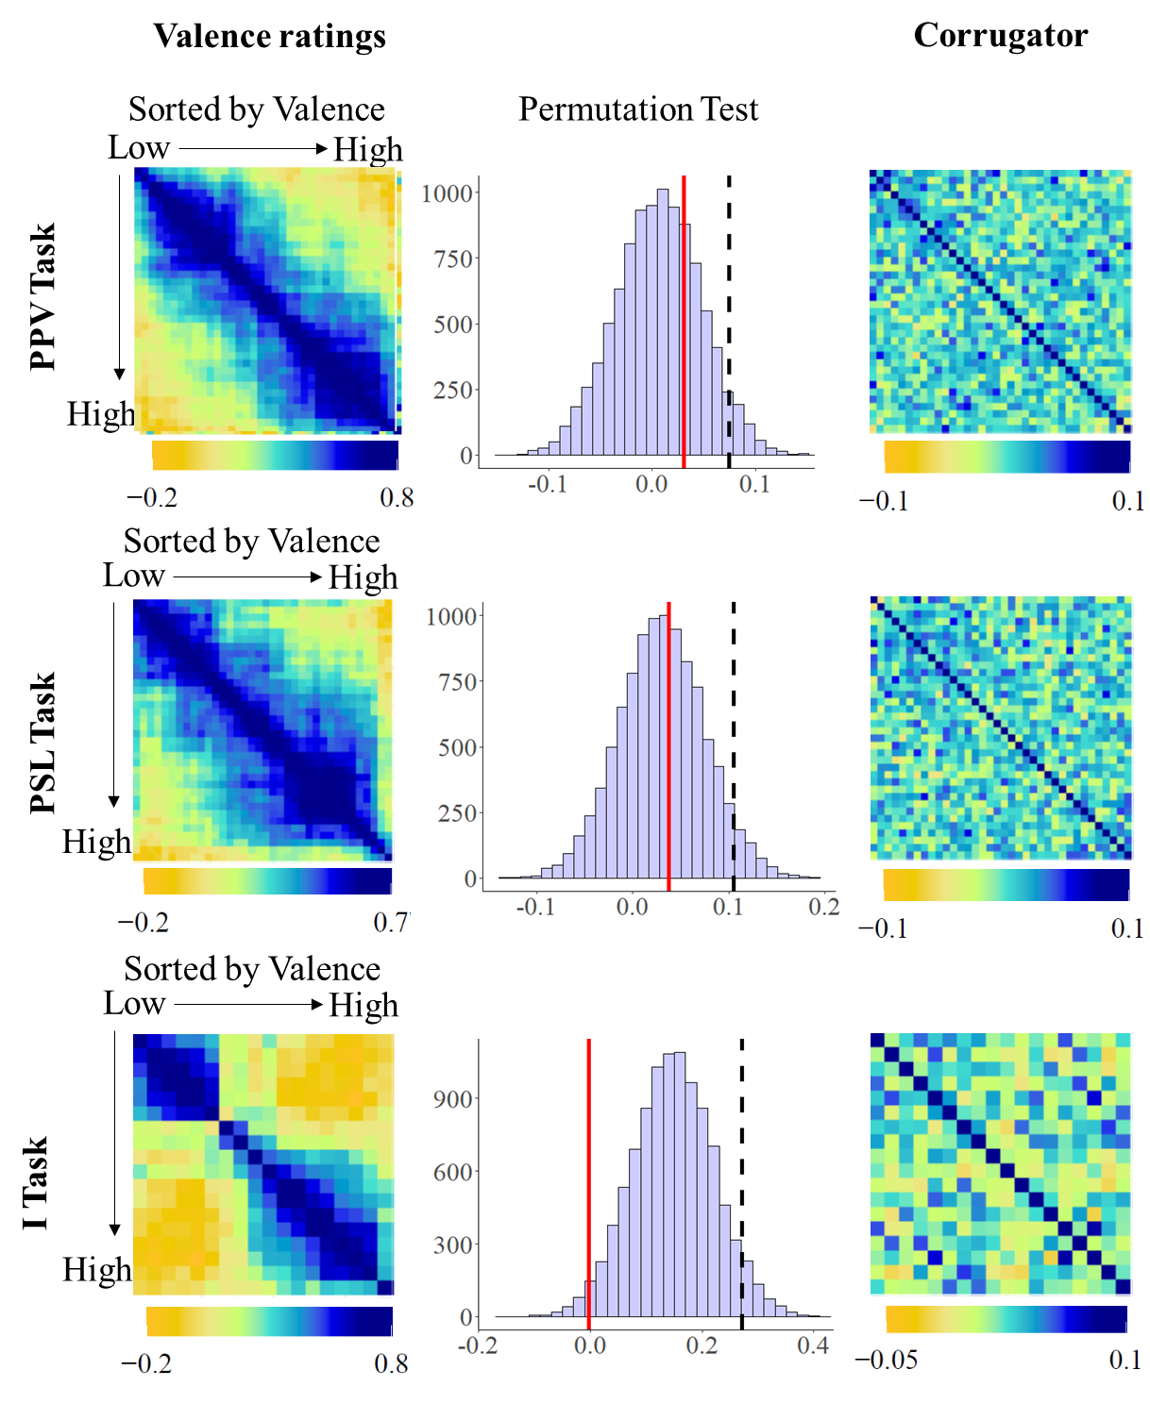
Results
VALENCE (& AROUSAL) AND STARTLE
VALENCE AND CORRUGATOR

Slide 15
discussion
RSA analysis did only reveal similarities between SCR and subjective arousal in the PPV paradigm.
For the other physiological variables and tasks no such relationship was observed.
These findings suggest that there is no clear match between the evoked physiological responses and the experienced subjective affect, supporting the Populations hypothesis
These results do not undermine the importance of physiological changes in the experience of affect but invite to reframe the relation between physiology and affect from invariant and homogeneous to variant and context-dependent (Hoemann et al., 2020).
These findings can be understood within an active inference approach, like the theory of constructed emotions (Barrett et al., 2017).

Slide 16
GOAL
1. Replicate similarity between arousal and SCR (across participants)
2. Compare these relationships between groups (high and low in any variable).
3. Extract for each individual a SCR-Behavioral similarity index and relate them to psychopathology.
What does a SCR-Behavioral index may mean?
Index of connection between physiology and affect-related constructs.
Reflecting accuracy in using physiological signals to categorize different instances in terms of affect (arousal or valence)?

Slide 17
Relationship Physiology Behavior
Relation between behavior-Physiology & Psychopathology (STAI, BDI, CTP)
Physiology: STR, SCR
Behavior: Valence and Arousal Ratings
Participants | Rxy | Psychopathology
P01 | Rxy1 | Score1
P02 | Rxy2 | Score2
P03 | Rxy3 | Score3
P04 | Rxy4 | Score4
Rxy
Extract a score for each participant

Slide 18
Bonus slides

Slide 19
INTRODUCTION
High
Hoemann et al. (2020)
Physiological patterns associated with participants’ subjective affective experience during a 2-week period.
Is a physiological pattern related to specific
affective state across participants?
Arousal
No specificity was observed between physiological patterns and the subjective state evoked. → Populations hypothesis
Low

Slide 20
INTRODUCTION
Hoemann et al. (2020)
Physiological patterns associated with participants’ subjective affective experience during a 2-week period.
Is a physiological pattern related to specific
affective state across participants?
No specificity was observed between physiological patterns and the subjective state evoked. → Populations hypothesis

